Slide 1


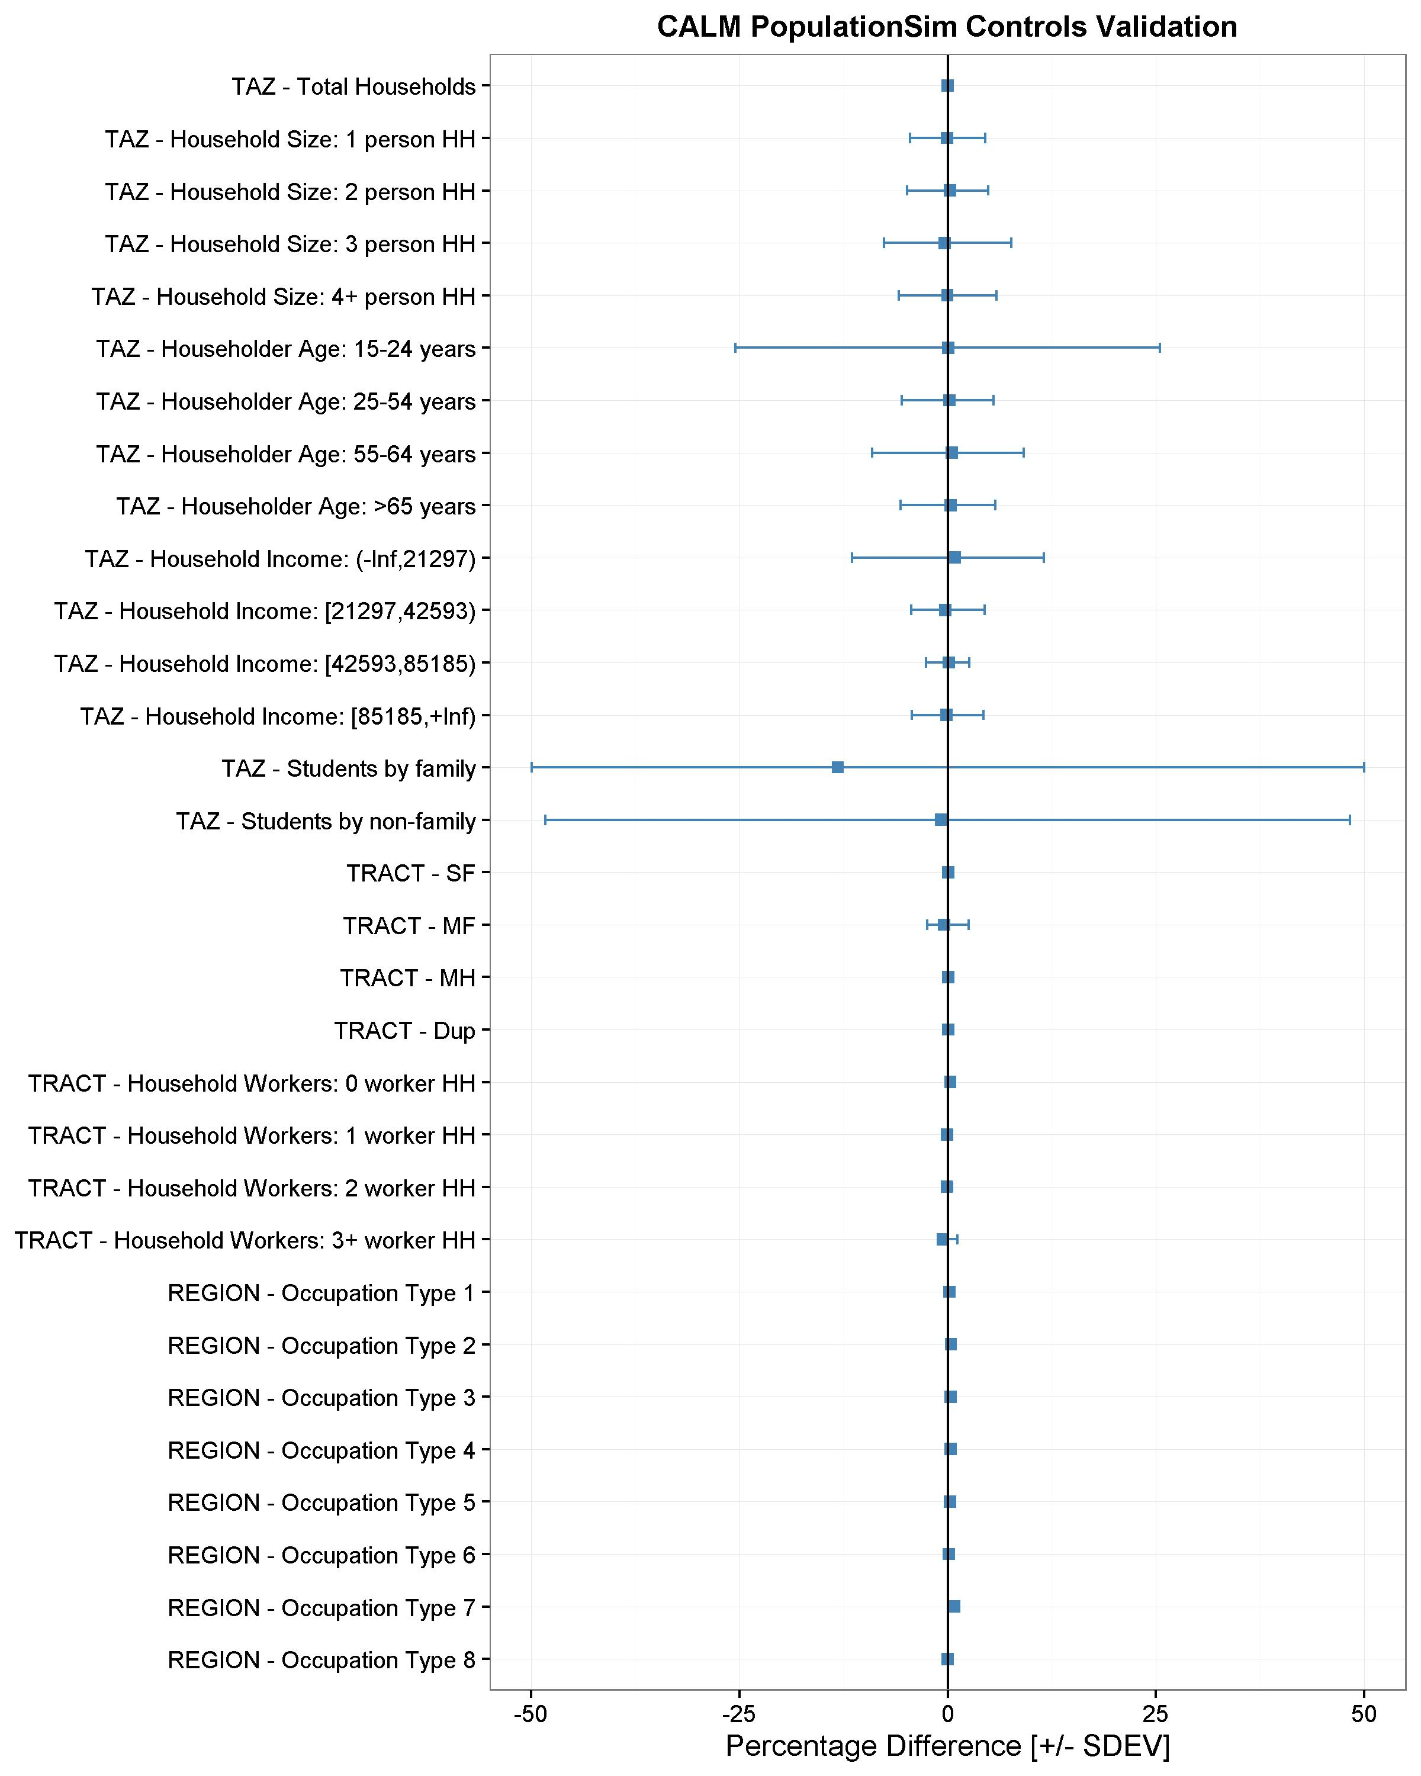
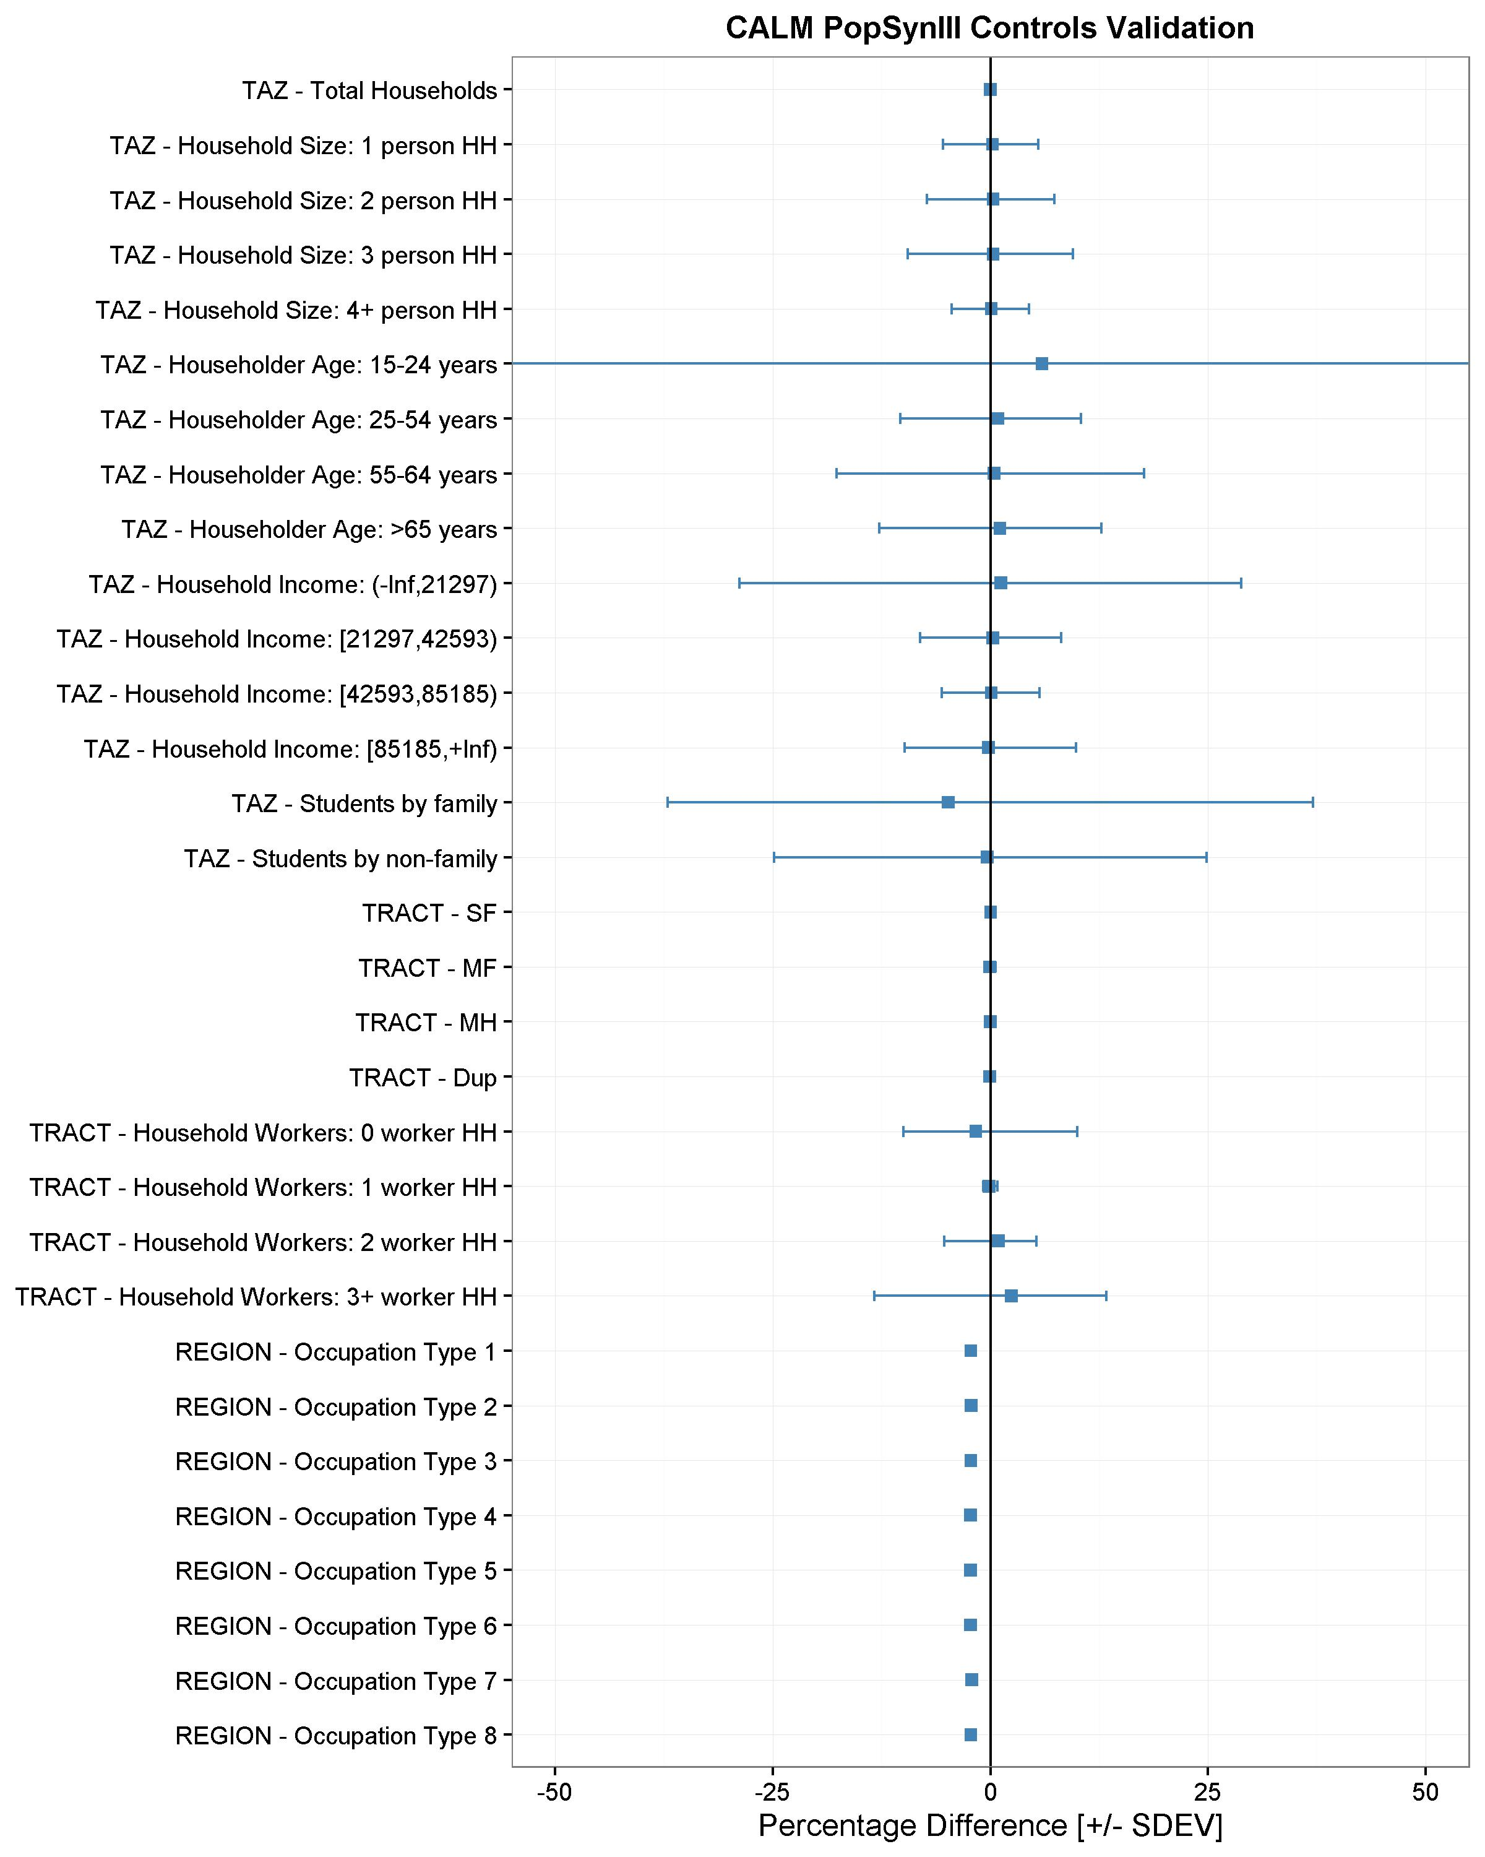
Multi-level Population Synthesis Using Entropy Maximization Based Simultaneous List Balancing
Binny M Paul, RSG
Jeff Doyle, RSG
Ben Stabler, RSG
Joel Freedman, RSG
Alex Bettinardi, ODOT
EXECUTIVE SUMMARY
2 PopulationSim ALGORITHM
4 RESULTS & VALIDATION
This work presents a population synthesizer based on entropy maximization - PopulationSim. It is implemented as part of the ActivitySim open-source modeling platform. Major contributions of this work are as follows:
An algorithm that utilizes list balancing coupled with a linear programming integerizer to simultaneously match controls across multiple geographies while observing global constraints.
A flexible user interface that allows the specification of an unlimited number of geographies.
A feature that allows adding to, or regenerating, the synthetic population for a subset of zones.
Relatively fast runtime and better fit to control data compared to other available population synthesis tools.
An open-source collaborative framework for model development.
PopulationSim is an extension of the maximum-entropy list-based approach developed as part of PopSynIII. PopulationSim includes following algorithmic enhancements:
Simultaneous List Balancing: Convex entropy maximization solved using iterative Newton-Raphson method
Simultaneous Integerization: Formulated as linear program, solved using or-tools
The Corvallis-Albany-Lebanon region of Oregon was used as a test region to validate PopulationSim against PopSynIII.
5% American Community Survey Public Use Microdata from 2007-2011 was used as seed sample.
Controls were specified at the PUMA (1), Census Tract (35) and TAZ (930) level
The synthetic population has 62,041 households and 156,452 persons, plus a major university (Oregon State University) with 17,510 students.
PopulationSim and PopSynIII were run on same set of controls and configurations settings. PopulationSim matches nearly all controls better than PopSynIII. Nearly identical runtimes – PopulationSim = 12 minutes, PopSynIII = 11 minutes (machine specs: Two 3.00 GHz processors and 160GB RAM).
HH ID | HH size |  |  |  | Person age |  |  |  | Final weight | Zone 1 weight | Zone 2 weight | Zone 3 weight
 | 1 | 2 | 3 | 4+ | 0-15 | 16-35 | 36-64 | 65+
 | i=1 | i=2 | i=3 | i=4 | i=5 | i=6 | i=7 | i=8 | W_{n} | W_{1n} | W_{2n} | W_{3n}
n=1 | 1 |  |  |  |  |  |  | 1 | 250 | w₁₁ | w₂₁ | w₃₁
n=2 |  | 1 |  |  | 1 | 1 |  |  | 250 | w₁₂ | w₂₂ | w₃₂
n=3 |  |  | 1 |  |  | 1 | 2 |  | 250 | w₁₃ | w₂₃ | w₃₃
n=4 |  |  |  | 1 |  | 2 | 2 |  | 150 | w₁₄ | w₂₄ | w₃₄
n=5 |  |  |  | 1 | 1 | 3 | 2 |  | 150 | w₁₅ | w₂₅ | w₃₅
Control(A_{i}) | 250 | 250 | 250 | 300 | 400 | 1250 | 1100 | 250
Control(A_{1i}) | 50 | 50 | 50 | 60 | 80 | 250 | 220 | 50
Control(A_{2i}) | 75 | 75 | 75 | 90 | 120 | 375 | 330 | 75
Control(A_{3i}) | 125 | 125 | 125 | 150 | 200 | 625 | 550 | 125
TABLE 1. Simultaneous List Balancing – Three Zone Example
1 MOTIVATION
3 SOFTWARE IMPLEMENTATION
This work aims to address the following shortcomings of existing population synthesizers:
Algorithmic Improvements: Error propagation to last zone when sequentially allocating population from upper to lower geographies.
Flexible Geographies: All well known population synthesizers prescribe a certain number of geographies. Flexible number of geographies is a desired feature.
Traffic Impact Studies: This requires ability to generate synthetic population for smaller geographies
Ease of use: Improved implementation for ease of use, maintenance and support.
Python based open-source ActivitySim framework (https://github.com/UDST/activitysim/wiki)
Uses CSV expression file of Python expressions for control specification
All inputs and outputs are provided in CSVs
All tables are stored in an intermediate Hierarchical Data Format (HDF5) binary file that allows restarting from any point
Flexible setup options – install dependencies manually or download easy setup that requires no software installation.
Note: Parallel processing planned for later release
Meta Controls
Factor Meta Controls
FIGURE 2. PopulationSim vs. PopSynIII Validation
META
Seed Weights summed to Meta Controls
5 LAST ZONE ERROR
6 CONCLUSIONS & FUTURE WORK
Seed Sample
Initial Seed Balancing
Factored Meta Controls
Final Seed Balancing + Integerization
PopulationSim algorithm resolves the last zone error as observed by performance of students by family type control for last TAZ in each Tract.
PopulationSim avoids algorithmic errors resulting from Monte Carlo drawing and sequential processing.
PopulationSim can handle multiple geographies and can be used to generate synthetic population for traffic impact studies.
Results show that PopulationSim eliminates the last zone error problem observed in PopSynIII
PopulationSim performs reasonably in terms of matching of controls at various geographies.
SEED
Agg Controls
Seed Weights
Final Seed Integer Weights
Zone Number (TAZ) | Control Value | (Control – Predicted)
 |  | PopSynIII | PopulationSim
OSU Students in Family Households
302 | 69 | 11 | 0
356 | 74 | 9 | -1
654 | 4 | 6 | 0
563 | 13 | 6 | -2
241 | 18 | 6 | 1
OSU Students in Non-Family Households
121 | 250 | -13 | 2
722 | 236 | 13 | 4
337 | 0 | 12 | 0
822 | 219 | 11 | -1
302 | 312 | -11 | -1
Agg Controls
Med Controls
Simultaneous Balancing & Integerizing
TABLE 2. Large Zone Error Best 5 Improvements (OSU student control)
MED
Med Controls
Agg Low Controls
Final Med Integer Weights
LOW
Low Controls
Low Controls
Simultaneous Balancing & Integerizing
Final Low Integer Weights
ACKNOWLEDGMENTS: Oregon Department of Transportation (ODOT), ActivitySim team
FIGURE 1. PopulationSim Algorithm (Four Geography Example)

